Slide 1
Loan Pre-Approval
Steven

Slide 2
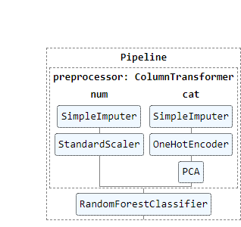
Process
Feature Exploration and Feature Engineering
Pre-processing
Inputting null values
Dummy variables for categorical features
PCA to reduce categorical features
Scaling numerical features
Running models to find optimal accuracy

Slide 3

Model Selection
Grid Search used to find best hyperparameters
Ridge Classifier | Random Forest Classifier | Logistic Regression
PCA Components = [2,3,4,5] alpha = [0.1,1] | PCA Components = [2,3,4,5] n_estimators = [100,150,200] max-depth = [2,3,4] | PCA Components = [2,3,4,5]
Accuracy Score: 74.8%

